Slide 1
Where are your
visitors dropping off?
NOW LET'S FIND OUT
May 25th - July 20th 2025, Own analysis

Slide 2
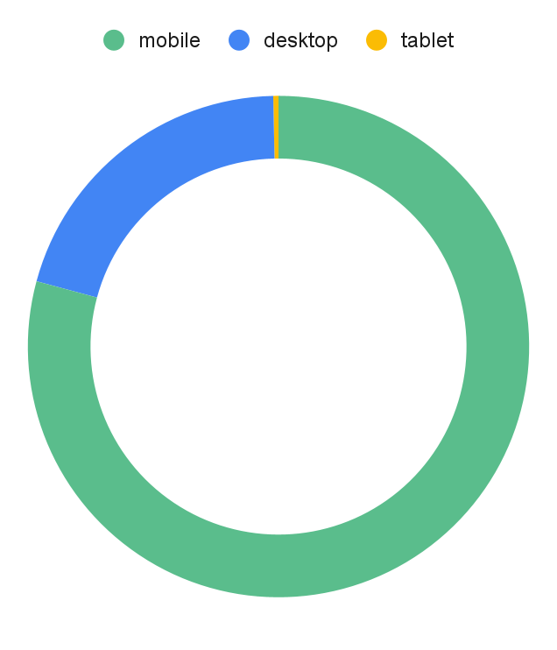
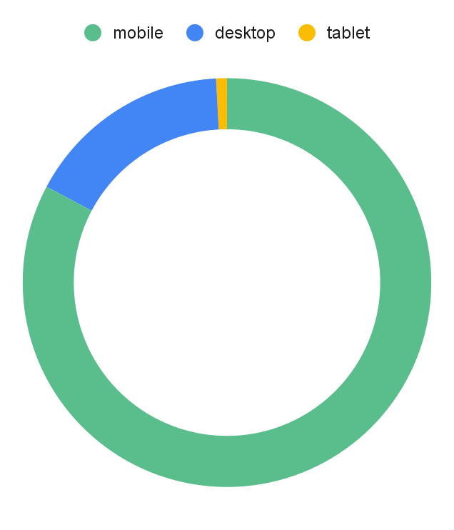
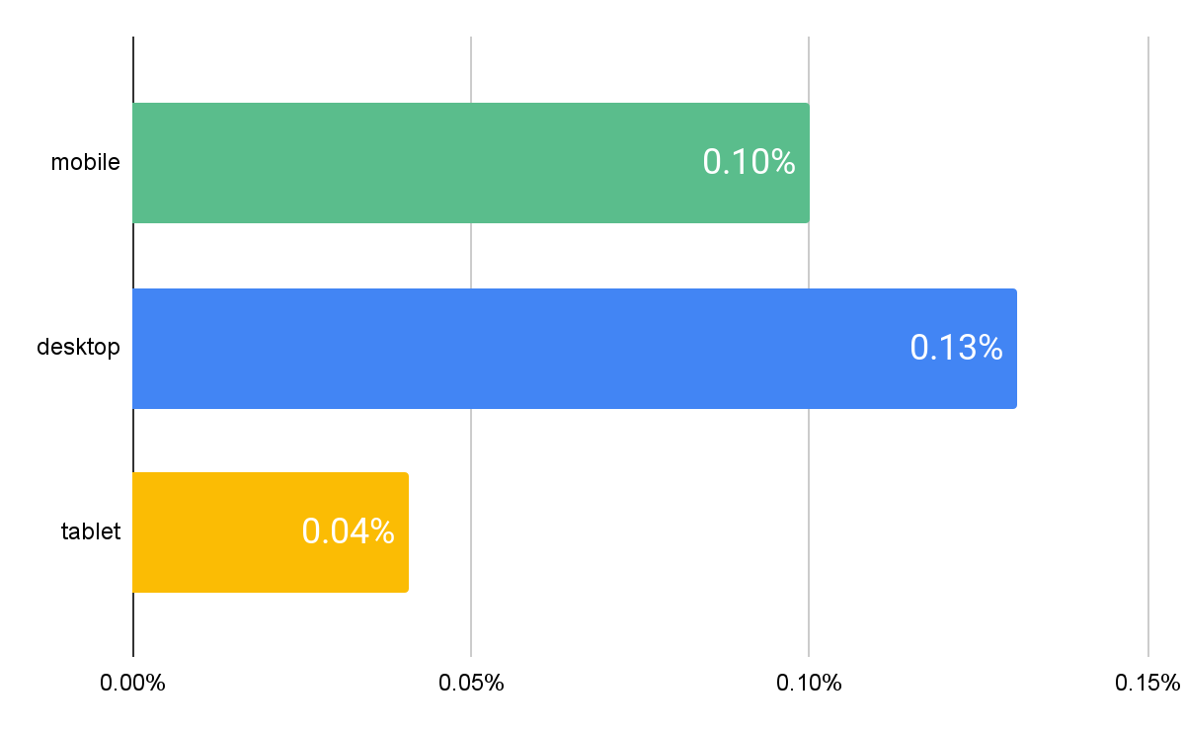
~82% of traffic comes from mobile devices; mobile devices bring 79% of transactions, while desktop contributes 20.2%
16.4%
20.2%
0.9%
3.9%
0.7%
82.8%
79.5%
User share by Device Type
E-commerce conversion rate
Conversion Rate by Device Type
Transactions by Device Type
Source: Shopify Analytics from Jun 8 - Aug 6, 2024

Slide 3
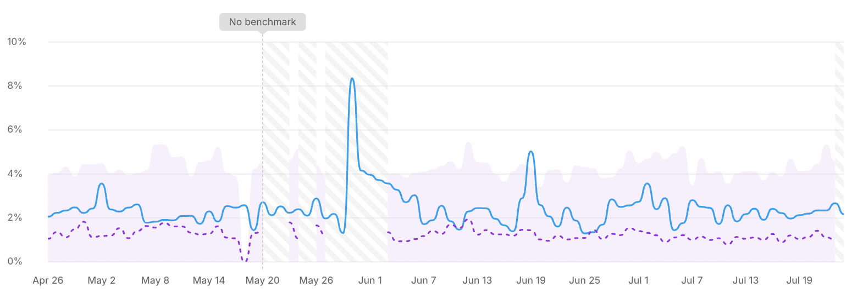
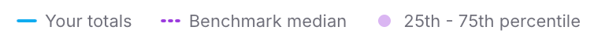
Your average CVR is higher than the median of similar stores but below than top 25% stores in your segment. Moving forward, we'll explore ways to improve further it
Your store’s average CVR (2.50%) is currently higher the industry median (1.23%) but significantly behind the top 25% of stores, which convert at over 4.22%. This gap presents a clear opportunity for growth, but also a reason for serious investigation and concern.
In the slides ahead, we’ll outline actionable strategies and key insights to help improve your conversion rates. By targeting high-impact areas and maintaining testing momentum, your store can first reach the industry average—and then work toward top-tier performance.
Your AVG CVR
2.50%
Your store’s current performance
Median CVR
1.23%
Peer benchmark—an industry-wide average
Top 25%
>4.22%
Top performance within your niche
This is you
Source: Shopify Analytics from April 26th - July 24th 2025, Own analysis

Slide 4
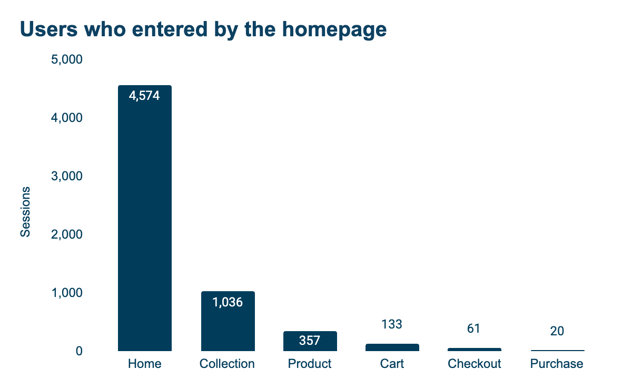
Uses who enter through the homepage have a big drop off (77%) and just 23% of them proceed to the collection page
Users who landed on the homepage had the lowest funnel conversion rate, just 0.44%. This is unusual, as homepage visitors typically explore more, become more familiar with the offer, and tend to convert better later in the funnel.
However, most users drop off before moving to other pages, and the cart rate drop-off is the lowest among all navigation paths.
This clearly shows that the homepage is not educating users or setting clear expectations from the start, leading to frustration and early drop-off.
28% ATC!
abandonment rate
77%
66%
63%
54%
67%
0.44% CVR
Source: GA Analytics from May 25- Jul 20 2025
Notes:
https://analytics.google.com/analytics/web/?authuser=1#/analysis/p488534709/edit/tX2XiW5IRjWGxxRTuspHtA

Slide 5
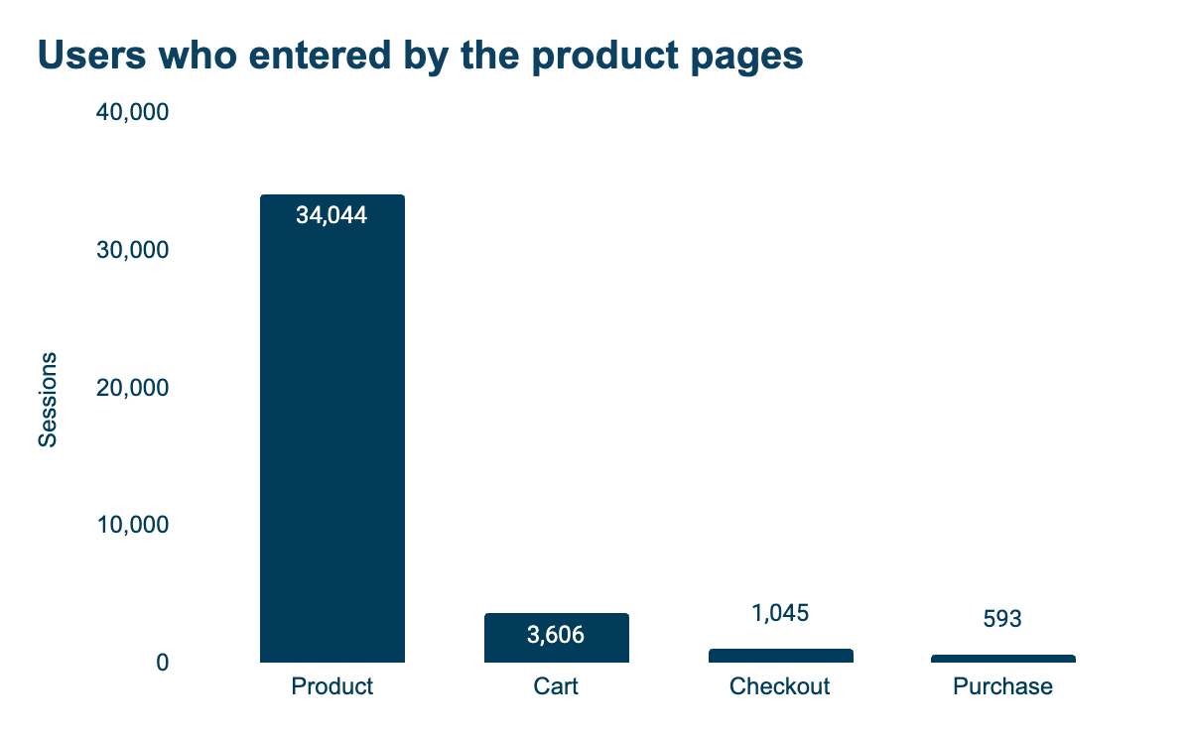
Even users who enter through the product also have a big drop off (89%) and just 11% of them adding products to their cart
A similar scenario happens here, but it’s somewhat expected: users also tend to drop off early when starting from product pages.
What’s surprising, and uncommon in most e-commerce sites, is that starting from product pages results in the highest final conversion and checkout rates. This suggests that the additional steps involved when users start from the homepage or collections are not persuasive or helpful in guiding them to the right product.
That said, when we look closely at product page performance, there’s still room for improvement, especially in reducing bounce rate and encouraging users to add more items to the cart.
Abandonment rate
89%
71%
43%
1.74% CVR
Source: GA Analytics from May 25- Jul 20 2025
Notes:
https://analytics.google.com/analytics/web/?authuser=1#/analysis/p488534709/edit/tX2XiW5IRjWGxxRTuspHtA

Slide 6
We should focus on improving the product page content for new users, mainly because of the higher bounce rate despite a good average session duration
Page | Sessions | % Sessions | Bounce Rate | Avg. Session Duration
Home | 4,587 | 8.0% | 9.5% | 1m 17s
Collection | 8,563 | 14.9% | 3.5% | 1m 11s
Product | 34,045 | 59.3% | 5.9% | 1m 34s
Cart | 6,748 | 11.8% | 2.3% | 1m 16s
Checkout | 3,448 | 6.0% | 8.6% | 2m 29s
Comparing different page types, it’s clear that product pages receive the majority of traffic (59.3%) and have a good average session duration (higher than other stages), but also show a significant bounce rate (5.9%). This highlights the importance of capturing users' attention in the first sections to prevent them from leaving the page too soon.
Source: GA Analytics from May 25- Jul 20 2025
Notes:
https://analytics.google.com/analytics/web/#/analysis/p333130545/edit/NW8R1XnPRNuY_ZLQ6M9cRA

Slide 7
We should invest in capturing more leads and it's possible to have a more aggressive approach with the Email channel. It’s also worth prioritizing Paid Shopping over Paid Search
Channel | % | Bounce | Session Dur. | % | eCVR | RPV | AoV
Referral | 31.8% | 3.76% | 0m 59s | 12.1% | 0.12% | $0.11 | $90.21
Cross-network | 16.7% | 6.03% | 2m 43s | 38.1% | 2.76% | $2.62 | $95.08
Paid Shopping | 11.5% | 3.99% | 3m 3s | 5.0% | 2.65% | $2.66 | $100.48
Direct | 10.9% | 12.00% | 2m 12s | 6.4% | 4.00% | $4.51 | $112.64
Paid Search | 9.2% | 7.58% | 1m 34s | 10.1% | 0.53% | $0.60 | $112.29
Email | 6.9% | 8.48% | 3m 22s | 9.6% | 8.22% | $9.49 | $115.48
Organic Search | 5.9% | 10.85% | 4m 17s | 6.0% | 3.67% | $3.91 | $106.53
Affiliates | 3.0% | 6.69% | 3m 49s | 7.3% | 3.62% | $2.91 | $80.34
Referral contributes 31.8% of users but has the lowest session duration, CVR, and RPV. This suggests that visitors coming from other websites are less interested in purchasing, and there’s room to improve the quality of backlinks.
Email marketing is the most effective channel, showing the highest AOV, RPV, eCVR, and session duration after organic search. We should focus on capturing more leads and consider being more aggressive with this strategy.
Paid search shows the second-lowest RPV and eCVR, in contrast to paid shopping, which performs over 2x better.
Organic search brings in fewer users, but with strong session duration, highlighting the value of investing in SEO.
Source: GA Analytics from May 25- Jul 20 2025
Notes:
https://admin.shopify.com/store/sexandcoffee-5740/analytics/reports/sessions_by_referrer?ql=FROM+sessions%0A++SHOW+online_store_visitors%2C+sessions%2C+bounce_rate%2C+average_session_duration%2C%0A++++sessions_that_completed_checkout%0A++GROUP+BY+referrer_source%2C+referring_platform+WITH+TOTALS%0A++SINCE+startOfDay%28-7d%29+UNTIL+today%0A++ORDER+BY+sessions+DESC%0A++LIMIT+1000%0AVISUALIZE+sessions+TYPE+horizontal_bar

Slide 8
The vast majority of the audience belongs to the new user category (91%) rather than returning users, but returning users bring +71% conversion
New / established | Sessions | % Sessions | Revenue | % Revenue | Transactions | AoV | eCVR | RPS
new | 323,738 | 91.4% | $270,067 | 76.1% | 237 | $1,139.52 | 0.07% | $1.20
established | 30,382 | 8.6% | $84,761 | 23.9% | 57 | $1,487.04 | 0.19% | $0.36
New vs Returning report
We should focus on attracting more returning users, as the current percentage of returning users is very low. Implementing more remarketing strategies, enhancing CRM, and possibly introducing loyalty programs could be beneficial.
Source: GA Analytics from Jun 8 - Aug 6, 2024
Notes:
https://docs.google.com/spreadsheets/d/13Q8uExUy2L2uek5RyF7kZT9DsF1P0MqKh_rdmCnDzCA/edit?gid=1213436519#gid=1213436519
https://analytics.google.com/analytics/web/?authuser=1#/analysis/p376534431/edit/son_8Z7eRIiXRLSwUk5D2Q

